Slide 1
3D ultrasound tomography and segmentation
J. Wiskin, B. Malik, M. Lenox

Slide 2
Quantitative 3D ultrasound tomography
Segmentation possible due to 3D quantitative accuracy
3D algorithm – necessity of 3D model of field
Proximity to the chest wall with 3D modelling of field
Retromammary fat – glandular interface
Retromammary fat – pectoralis interface
“Distribution of cancers in the breast is uneven with clusters in the posterior tissue region – the retromammary fat glandular interface is an important area for cancer”

Slide 3
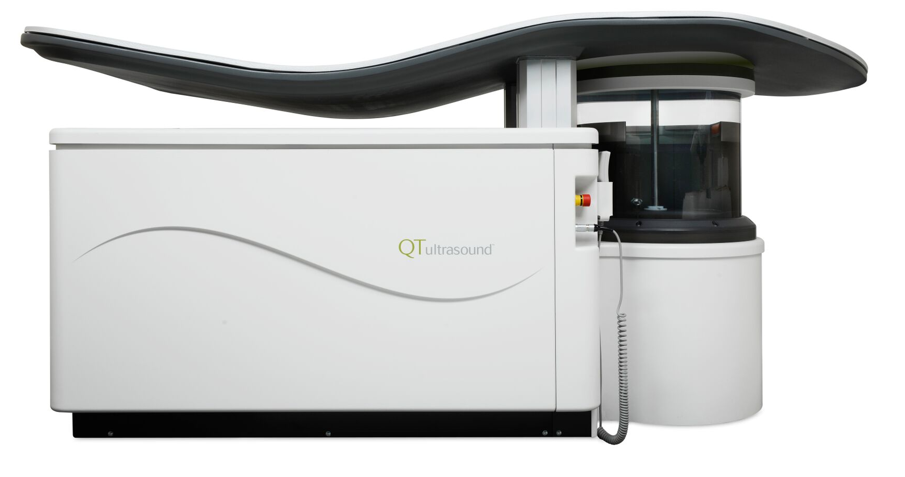
Profile view – Scanner 2000 Model A
Receiver array
transmitter
Water bath

Slide 4
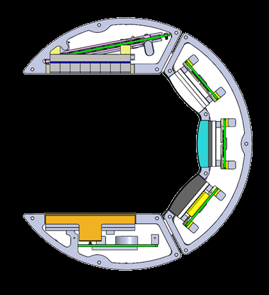
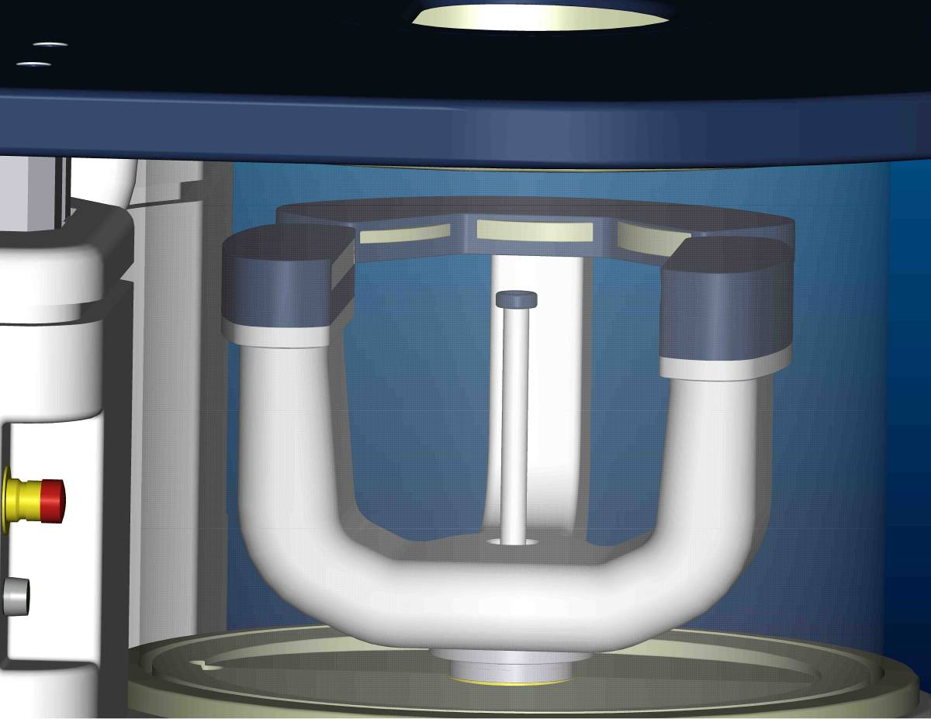
QT Data Acquisition System
Receiver array
Reflection arrays
Total field
transmitter

Slide 5
Vertical cross section of field
Vertical cross section of total field allows us to reconstruct ~30 mm above central data plane
20 mm tall
8 row multi-element receiver
transmitter
3D nonlinear full wave form inversion: Nonlinear Conjugate Gradients (RP)(Wiskin, Borup et al. 2017)
Notes:
3D nonlinear conjugate gradient minimization of ~40 million uknowns

Slide 6
2D vs 3D algorithm
2D: one level of data affects only one level of the image
3D: one level of data contributes to multiple levels of the image
Data levels
2D Image space
3D Image space

Slide 7
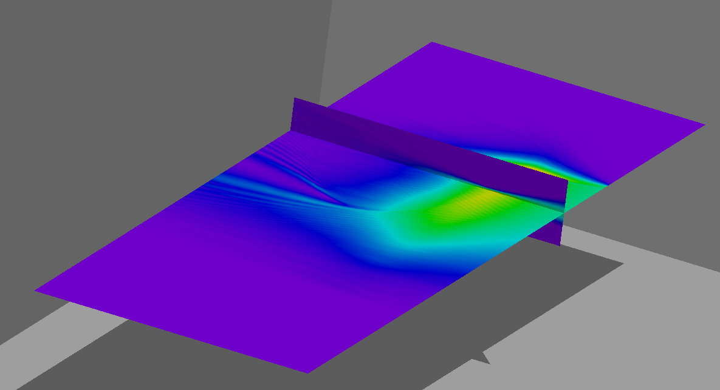
3D nature of transmitted field
Water bath
receivers
Interaction of field with Breast
Transmitter

Slide 8
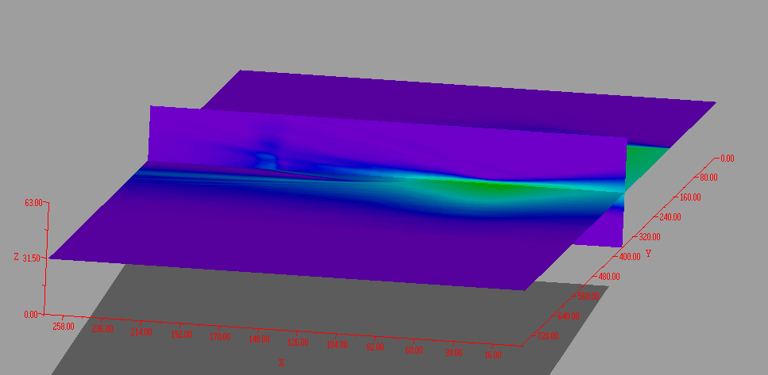
3D transmitted field
Water bath
Transmitter
receivers

Slide 9
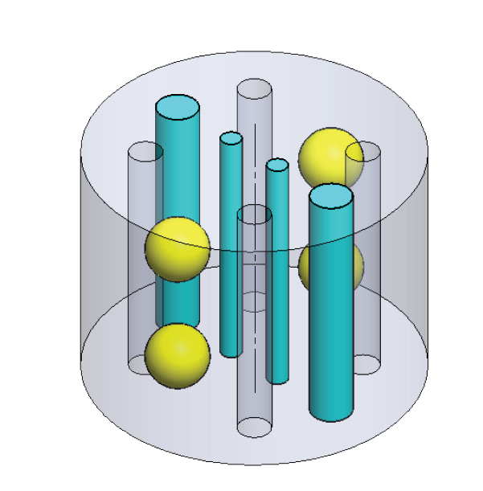
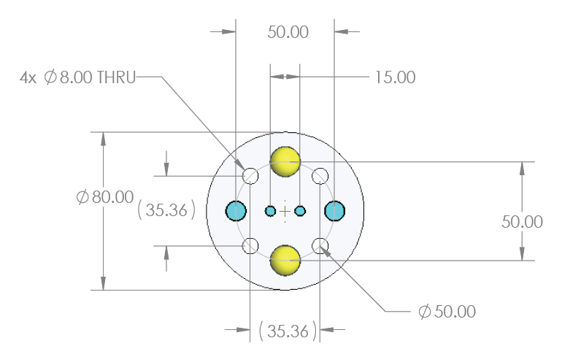
Test phantom
High speed rods
High speed sphere
Low speed sphere
holes

Slide 10
Reconstruction at mid-level
Water filled rods
Low speed sphere
Low speed sphere
Low speed rod
Low speed rod
Low speed rod
High speed sphere
High speed sphere
Hole filled with water

Slide 11
Segmentation - Internal structure of acceptance phantom
Segmentation based on QT Ultrasound Image
Note the ‘twist’ in the high speed rod – this objectively present – not an artefact
Clearly shows the high speed rods (2) and high speed spheres (2) and water speed holes (4)

Slide 12
Schematic for vertical positioning of acceptance phantom
5 mm cap
Water level
2 mm
15 mm
20 mm
receiver

Slide 13
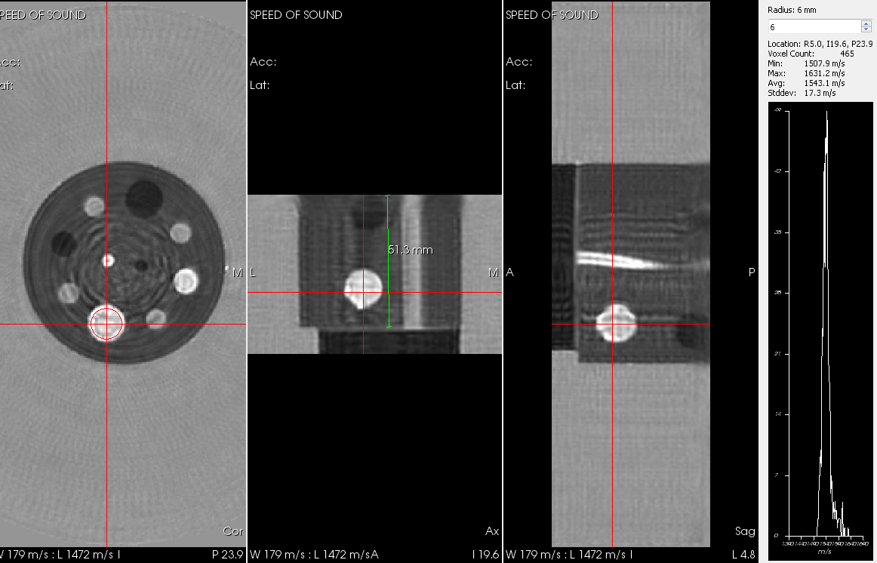
15 mm spheres - ROI fast sphere
Speed of sound higher than background and water
Note the ‘twist’ in the high speed rod
Notes:
Twist mentioned earlier, note the reconstruction of the low speed of sound

Slide 14
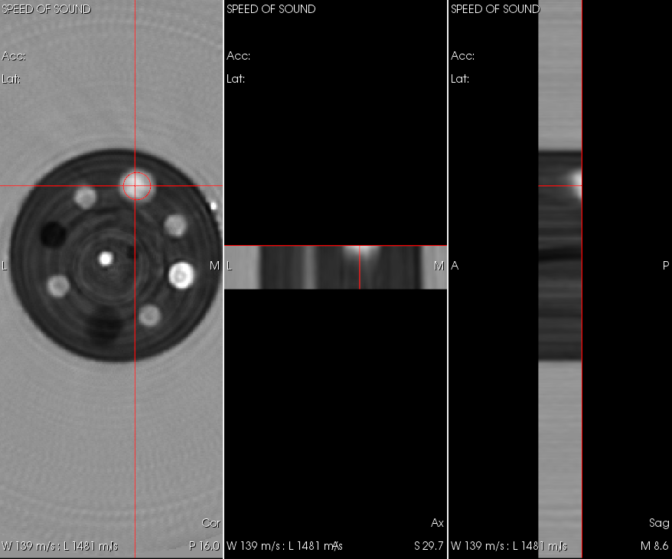
2D reconstruction
Bottom of sphere
Very top of the reconstruction – red line
Sphere is not reconstructed with 2D algorithm – yellow arrow
Notes:
Note the bottom of sphere

Slide 15
3D reconstruction
Near the top – sphere is visible – totally reconstructed
Water level
Top of 2D image is here
Notes:
Recall the vertical extent is ~64 mm, should be roughly slightly below center of sphere: 2 mm + 5 mm = 7 mm, 7.5 mm center to top of phantom

Slide 16
Quantitative values – can be segmented
Sphere can be segmented out in the 3D image
geometry of sphere clearly visible
segmented out from fat-like background

Slide 17
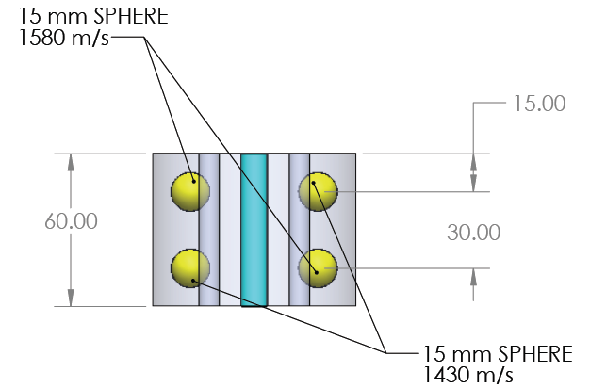
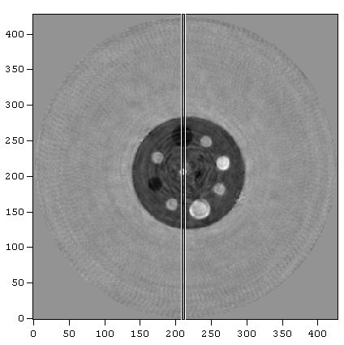
Quantitative accuracy - Line plot through reconstruction
Low speed sphere
This level
High speed rod

Slide 18
Line plot through 3D recon of phantom
QT reconstruction
True value
Line plot
Low speed rod
High speed rod

Slide 19
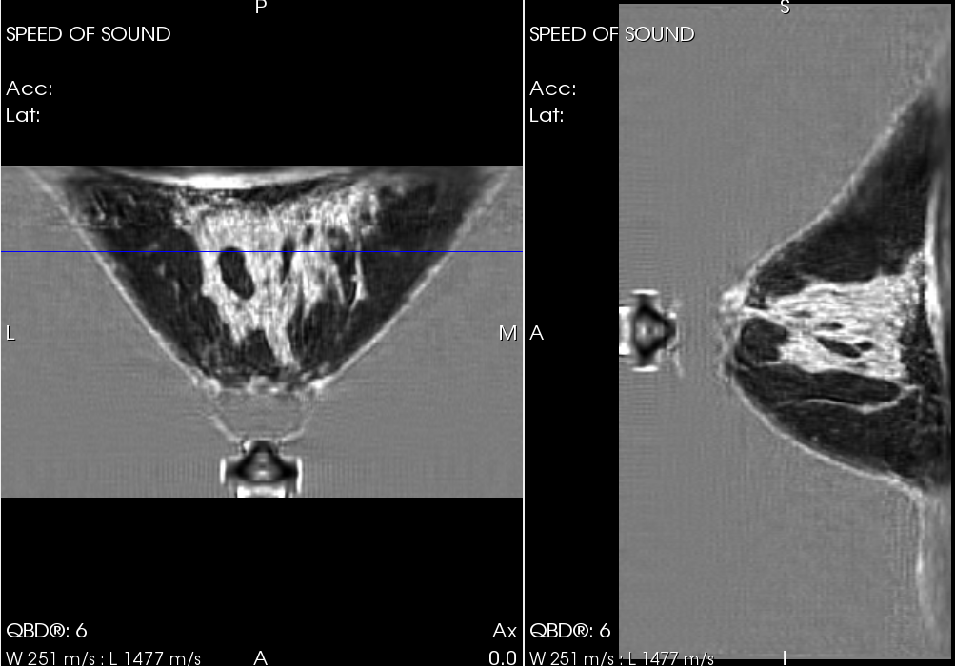
Medium heterogeneous breast
Pectoralis visible
High resolution 3D does show pectoralis
Retro-mammary fat - glandular interface
Inframammary fold also visible
Inframammary fold
19dea

Slide 20
Movie showing difference 2D vs 3D reconstruction
Pectoralis muscle
3D image
2D overlaid
Notes:
Pectoralis visible, retromammary fat pectoralis interface retromammary fat – glandular interface

Slide 21
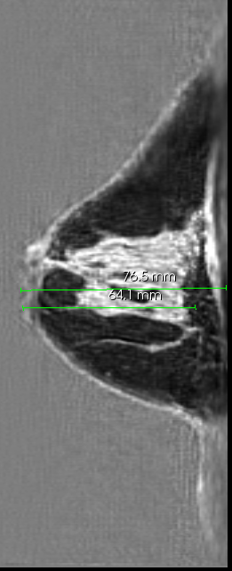
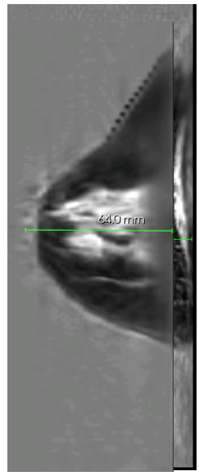
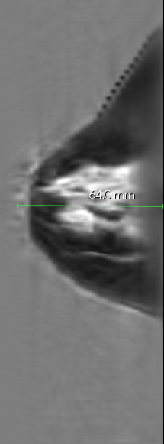
2D vs 3D Sagittal
2D image
3D image
2D overlaid on 3D
Upper extent of 2D

Slide 22
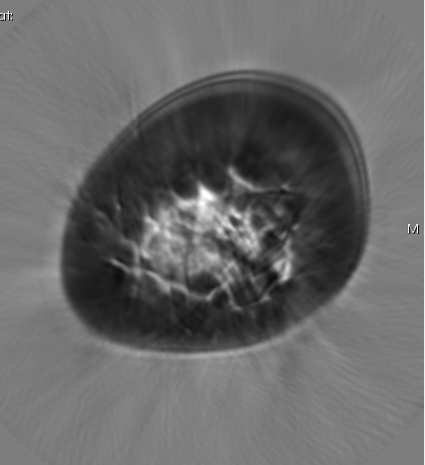
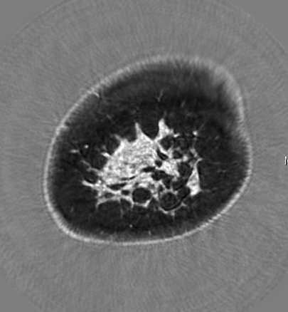
2D vs 3D Coronal view
2D – high resolution, high frequency image
3D – high resolution, high frequency image

Slide 23
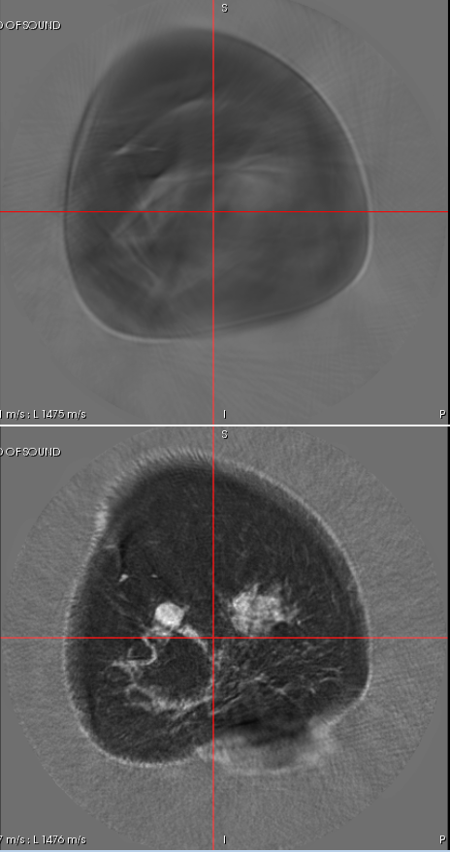
Scattered density breast near chest wall
The same level is properly reconstructed in 3D
3D extends the image at least an additional 11 mm
2D
Same level in red line 2D vs 3D
3D
~30 mm of field
Notes:
2D image shows degradation of resolution near the chest wall. Even before the top is reached there appears to be a significant reduction in image quality. This emphasizes the importance of 3D. Note also near the nipple region there is significant loss of resolution, again where the 3D curvature is high.

Slide 24
Sagittal view 2D vs 3D
Red line shows same level
Resolution preserved
Additional 11 mm or more added
Note the staircase
Effect in the 2D image
Note the high 3D curvature
Inframammary fold visible

Slide 25
2D vs 3D – Sagittal view – small dense breast
cranial
Sagittal view – additional tissue visible – skin line visible
Pectoralis
Retromammary fat – glandular interface visible
2D reconstruction
High frequency
High definition
0.5 mm pixels
caudal

Slide 26
3D representation of Fibroglandular tissue - movie
Crude segmentation based on speed of sound – still of some value

Slide 27
AI based segmentation
Based on AI: (Malik, Klock et al. 2016)
Skin, fat, connective tissue, ducts, glands, fibroadenomas and cancers

Slide 28
Segmentation II – based on QT Ultrasound Images
Skin,
fat,
connective tissue,
ductal tissue,
glandular tissue
Movie generated from segmentation of QT Ultrasound images (DICOM)
Notes:
Retromammary fat pectoralis interface, and retromammary fat glandular interface, glands pink, ducts red, cancer
Segmentation possible due to 3D quantitative accuracy
Skin, fat, connective, ducts, glandular, cysts, fibro-adenomas, cancers
Pectoralis is distinguishable
3D algorithm – necessity of 3D model of field
Quantitative throughout breast volume
Hi Resolution through breast volume: all three views
One data level affects multiple image levels

Slide 29
Conclusions - Quantitative 3D ultrasound tomography
Segmentation possible due to 3D quantitative accuracy
Skin, fat, connective, ducts, glandular, cysts, fibro-adenomas, cancers effectively segmented
3D algorithm – necessity of 3D model of field
Quantitative throughout breast volume
Hi Resolution throughout breast volume: all three views
One data level contributes to multiple image levels
Pectoralis - retromammary fat interface visible

Slide 30
QT Ultrasound, LLC
Acknowledgements
N. Pirshafiey, R. Terry, M. Racosky – design/construction of phantom
D. Borup, Ph.D. - theory
V. Zhang, Ph.D., A. Terry – discussion and experimental
J. Helms, Lightstream Animation studios – segmentation movie

